Slide 1

Web technologies using java
Course 7 – REST webservices

Slide 2
agenda
Exception handling
Error responses
Input validation

Slide 3
Exception handling
cross-cutting concern
application-wide strategy that handles all errors in the same way
@ControllerAdvice

Slide 4
Error responses
provide correct HTTP status code on the response
provide helpful, fine-grained details regarding the error in the response body; the following are provided by Spring Boot:
timestamp - the time in milliseconds when the error happened
status - HTTP status code associated with the error; this is partly redundant as it is same as the response status code
error - the description associated with the status code
exception - the fully qualified path to the exception class resulting in this error
message - the message providing more details about the error
path - the URI that resulted in the exception
NOTE: Please see Chapter 3 “Interaction Design with HTTP”, Section “Response Status Codes” from REST API Design Rulebook for best practices on the error response codes.

Slide 5
Input validation
JSR 303 validation: an API intended to simplify field validation in any layer of the application
Bean Validation API:
built under the JSR 303/349 validation specifications
provides a metadata model for JavaBean validation via a set of standardized validation constraints
domain object properties are annotated with validation constraints:
Hibernate Validator, a popular JSR 303/349 implementation framework
400 Bad Request should be returned as a response status in case the validations fail

Slide 6
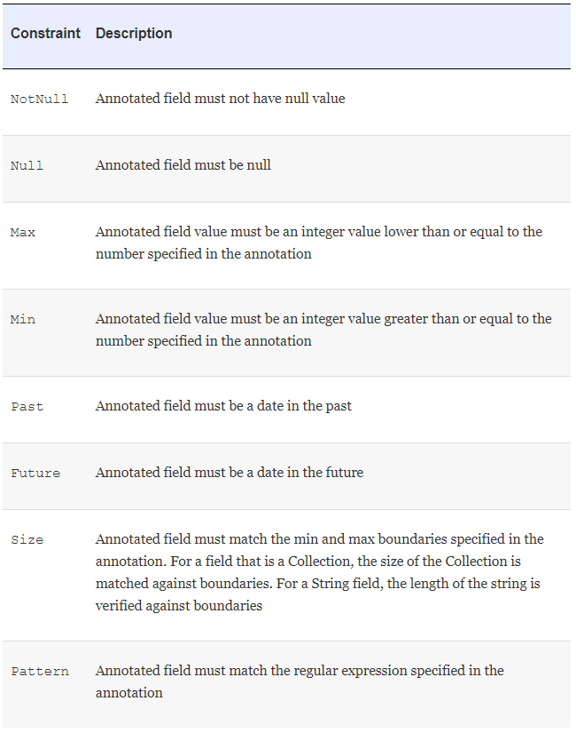
Input validation

Slide 7
bibliography
Spring in Action, by Craig Walls
Spring REST, by Balaji Varanasi, Sudha Belida
REST API Design Rulebook, by Mark Masse
Architectural Styles and Design of Network-based Software Architectures
JSR 303: Bean Validation

Slide 8

Q&A

Slide 9
THANK YOU
DANIELA CIUPERCA

